Slide 1
MODEL-BASED PRODUCT LINE TRADE STUDIES WITH POWER BI VISUALIZATION
Gary Kliczinski / Ryan Pykor

Slide 2
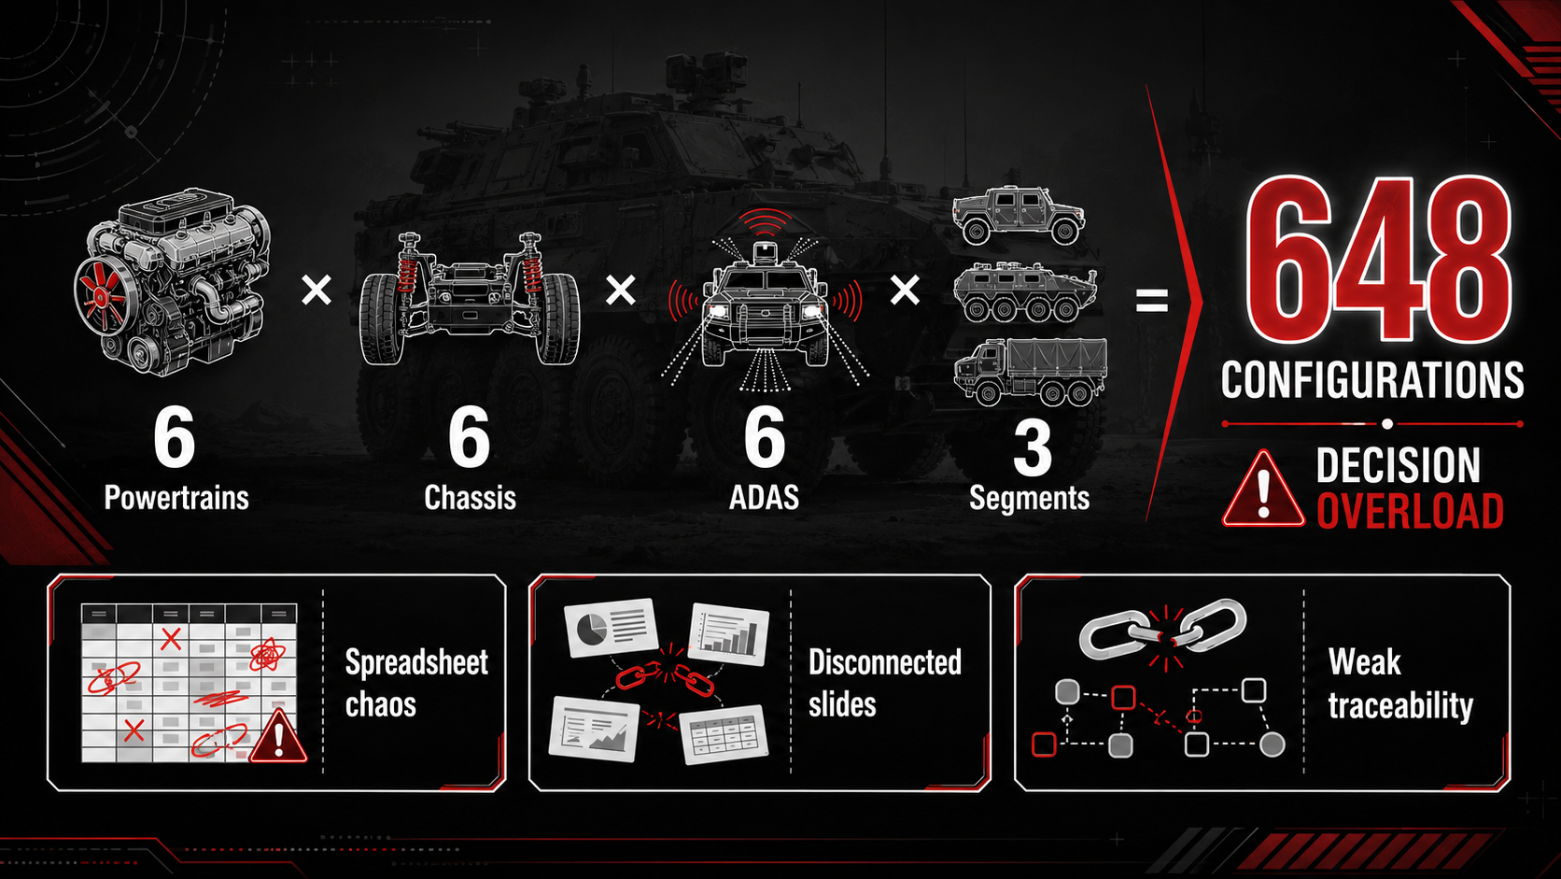
The Problem:
Product-Line Trade Studies Don’t Scale Well

Slide 3
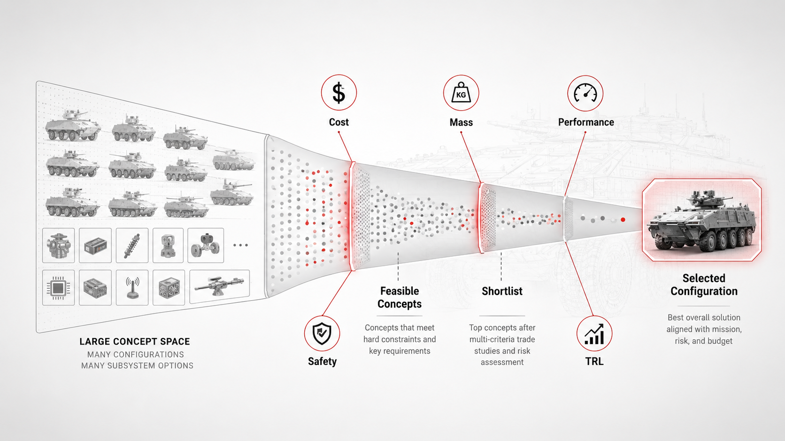
Why the Front-End Decision Matters

Slide 4
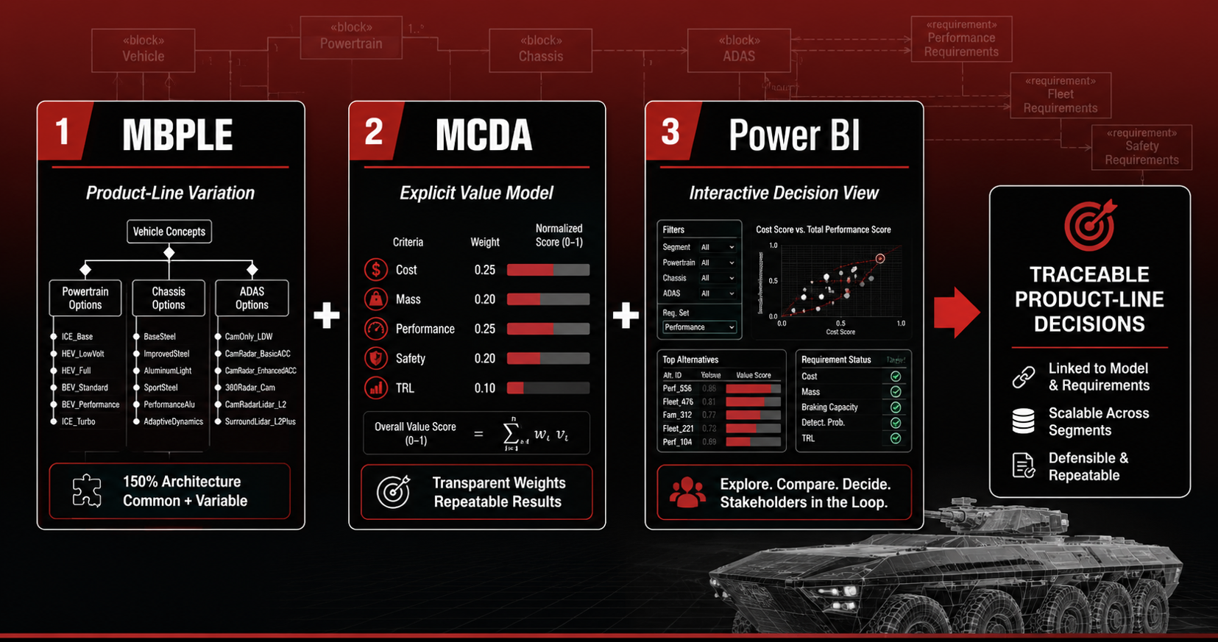
The Core Integration

Slide 5
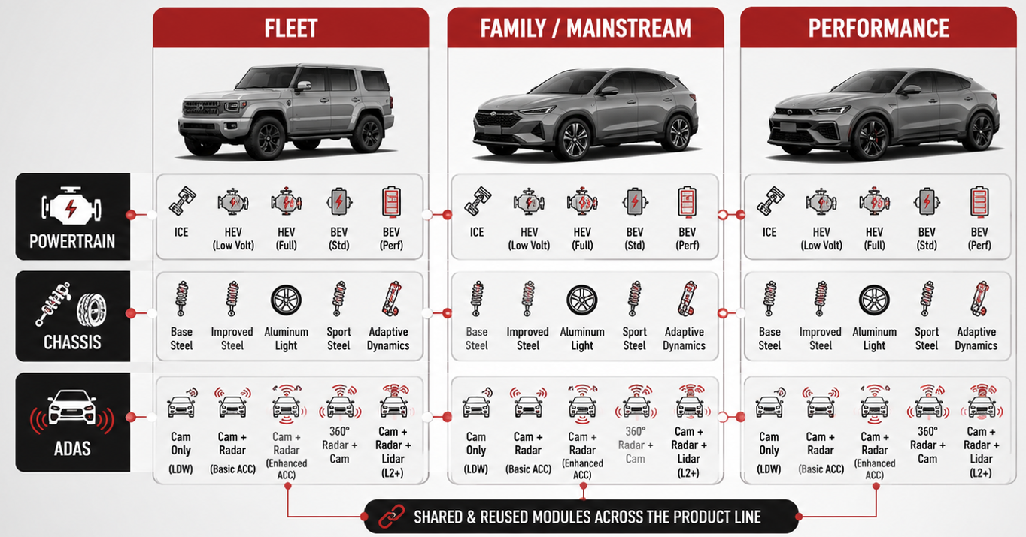
Case Study Setup:
A Configurable Vehicle Family

Slide 6
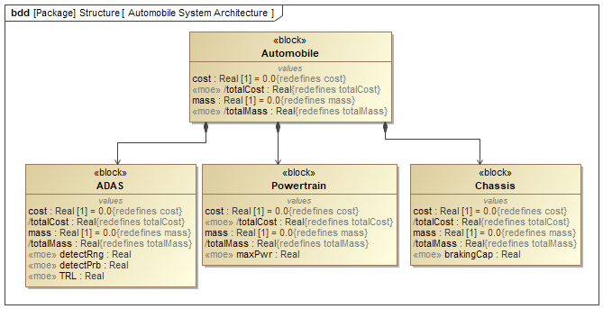
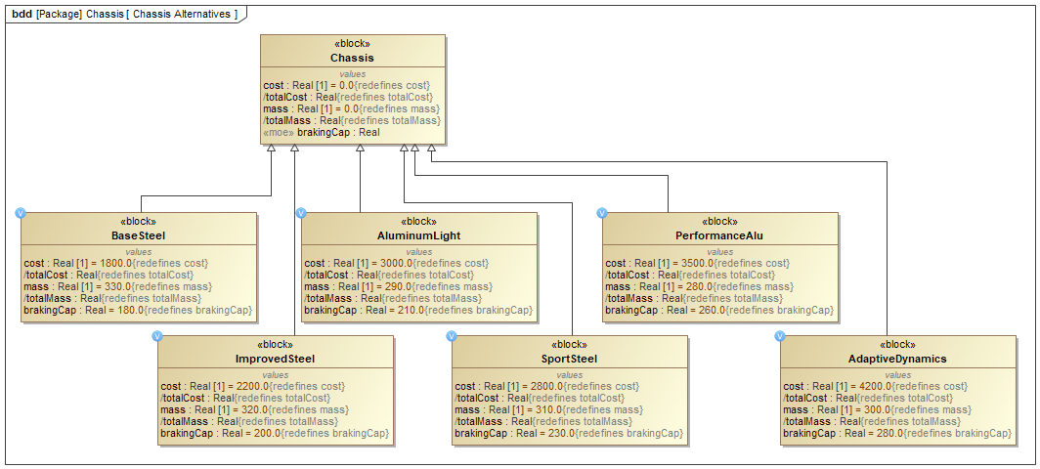
150% Architecture:
One Superset, Many Products

Slide 7
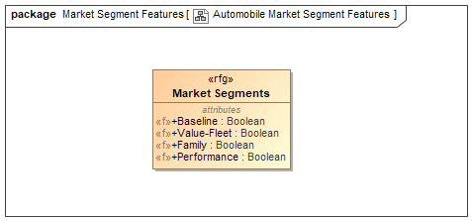
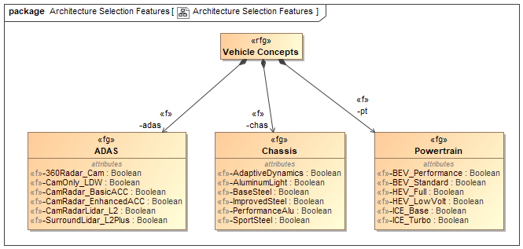
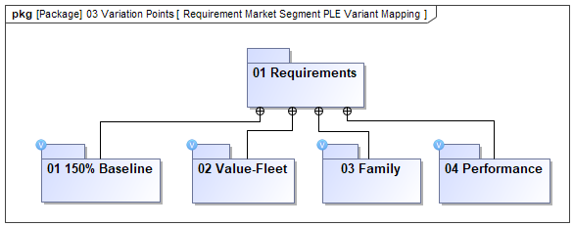
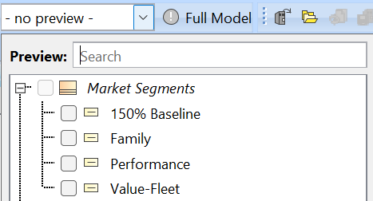
Alternatives Become Trade-Study Features

Slide 8
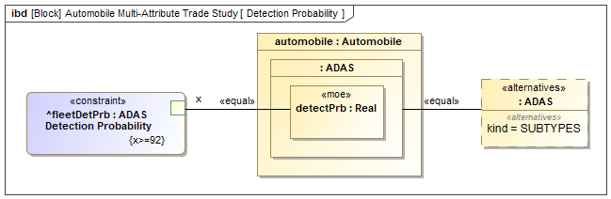
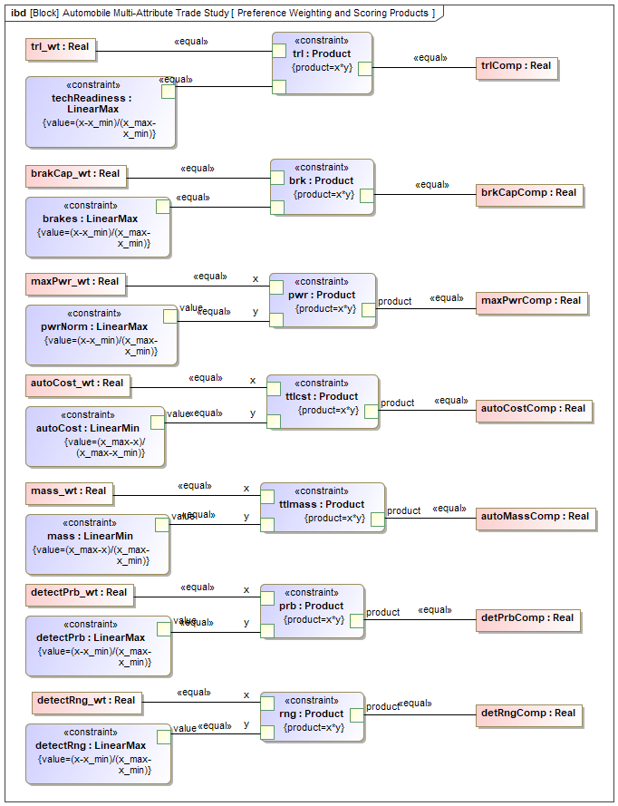
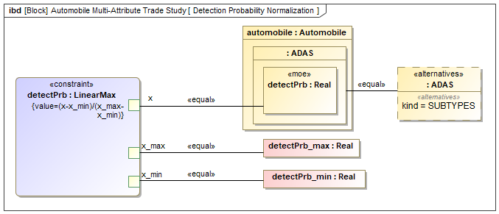
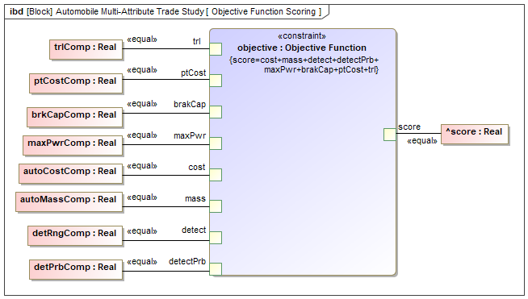
The Model Computes the Engineering Attributes

Slide 9
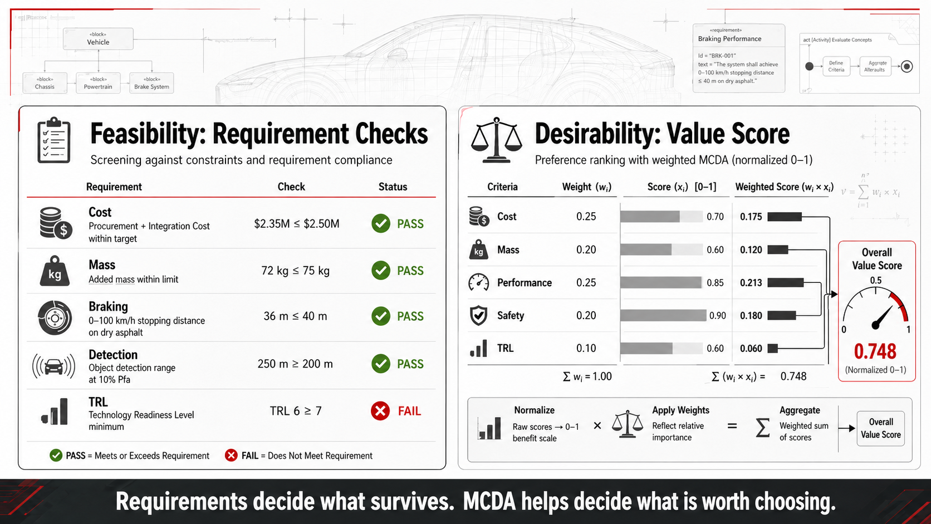
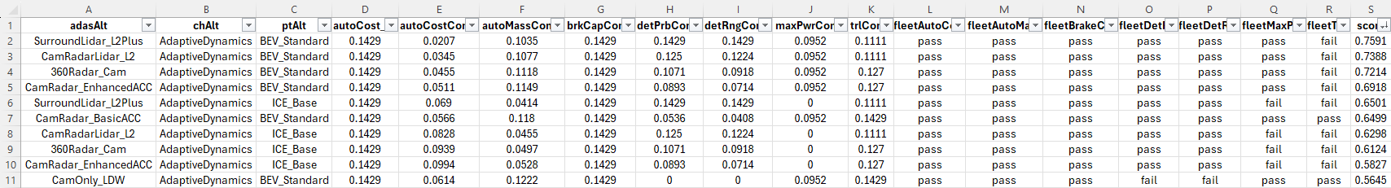
MCDA: Feasible vs. Desirable

Slide 10
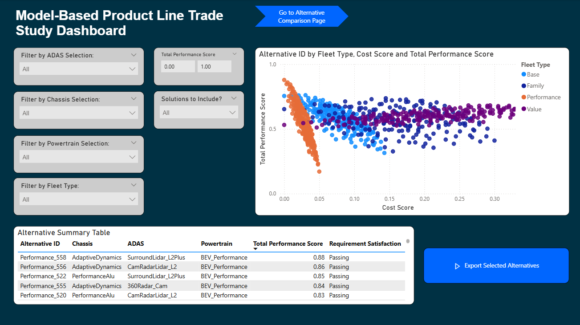
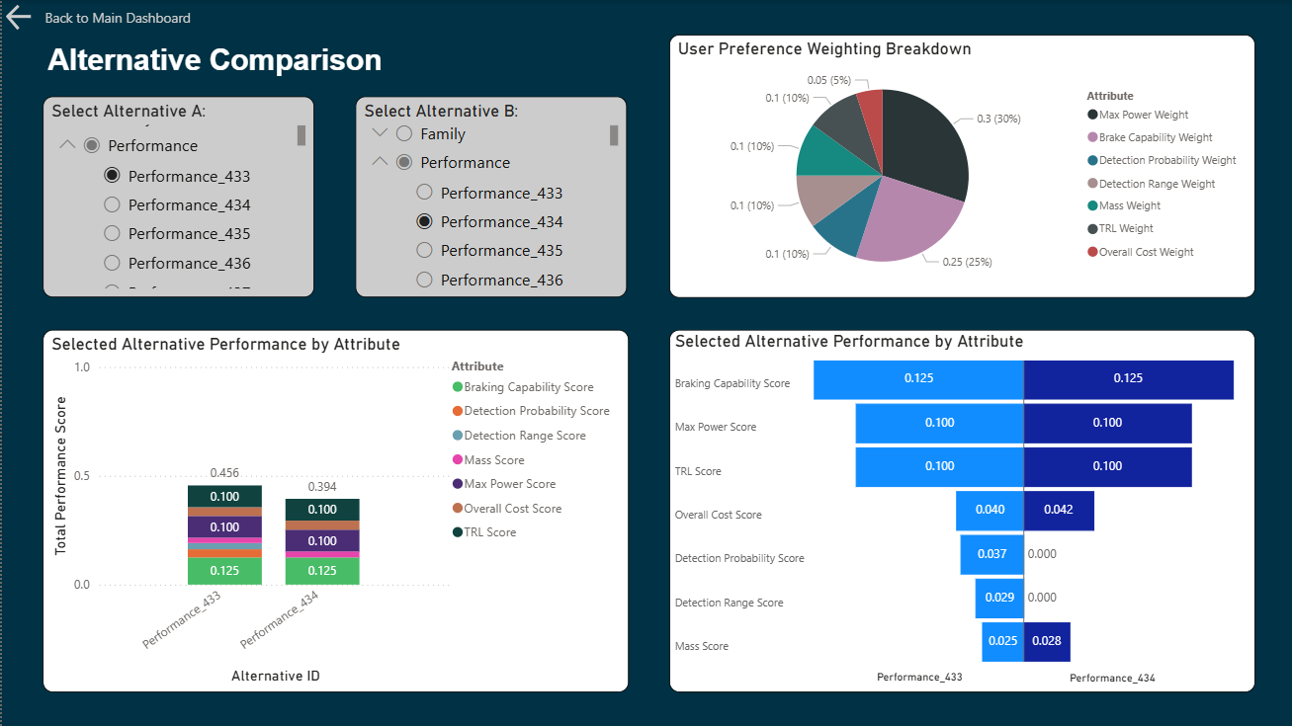
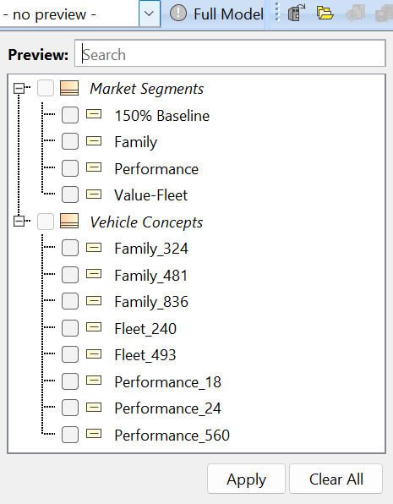
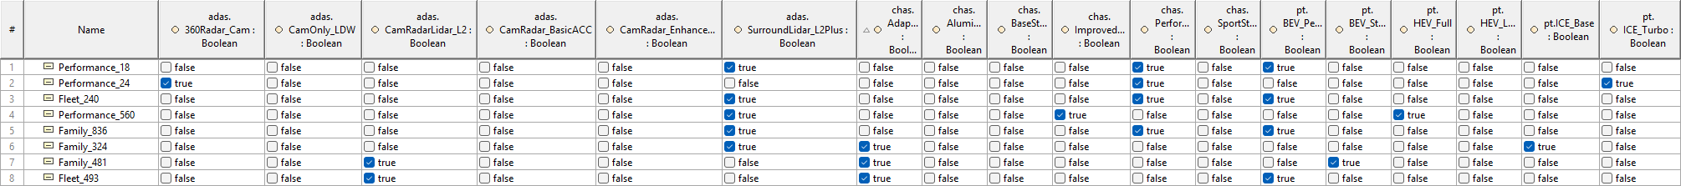
Power BI: The Decision Room View

Slide 11
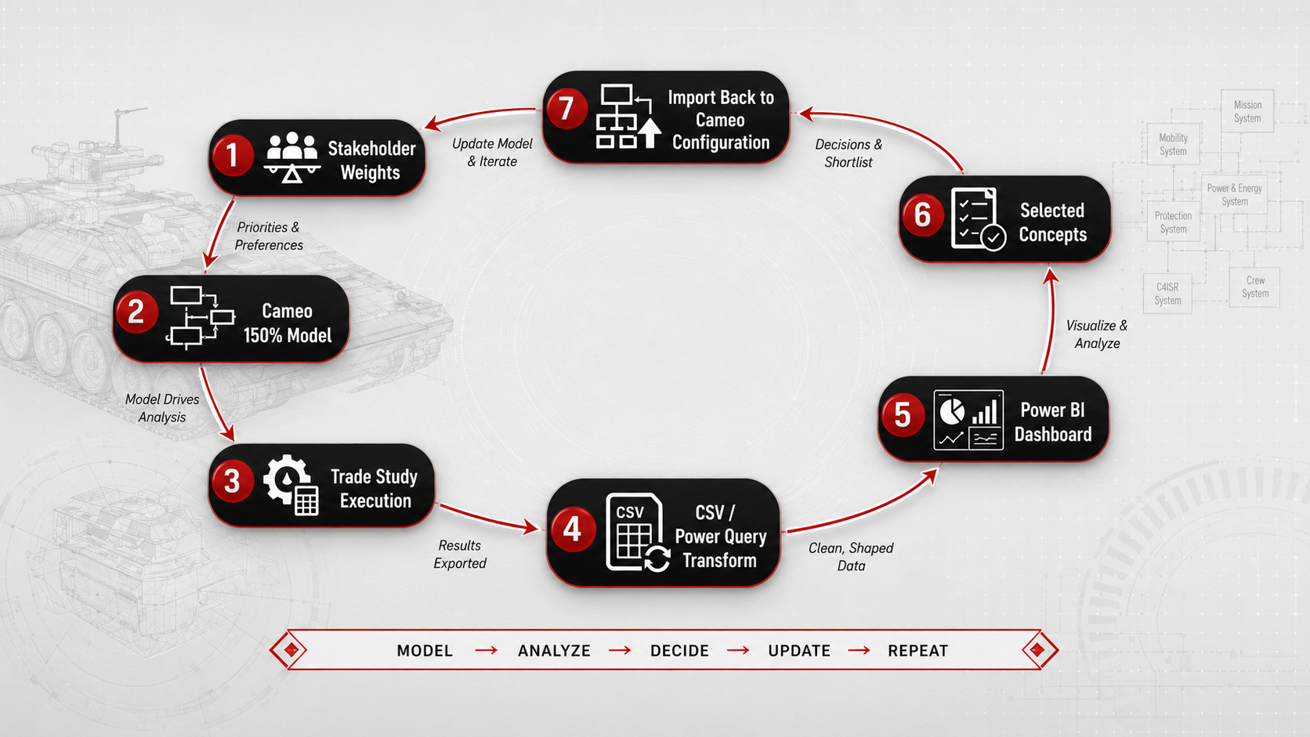
Closed-Loop Workflow

Slide 12
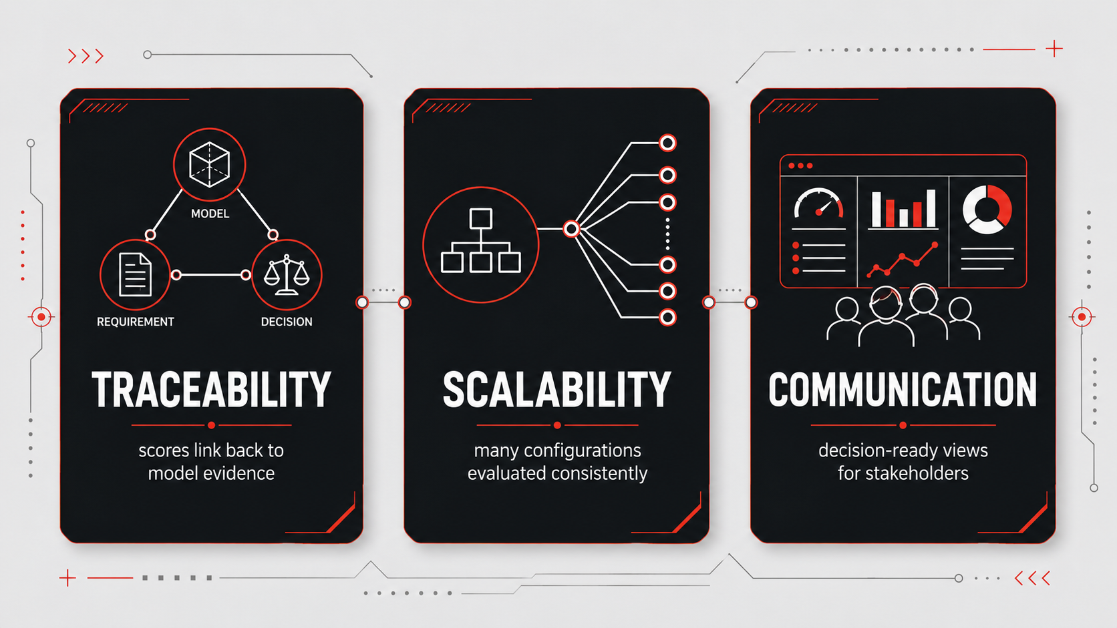
What This Improves

Slide 13
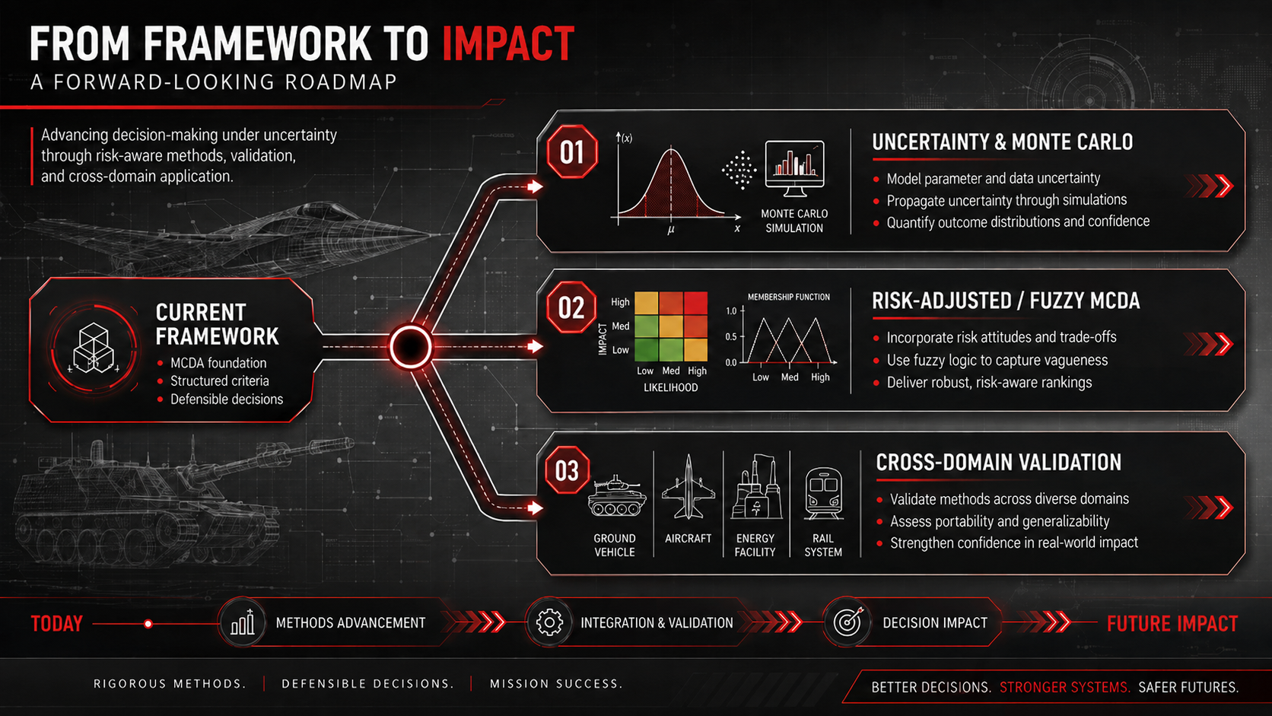
Limitations and Future Work

Slide 14
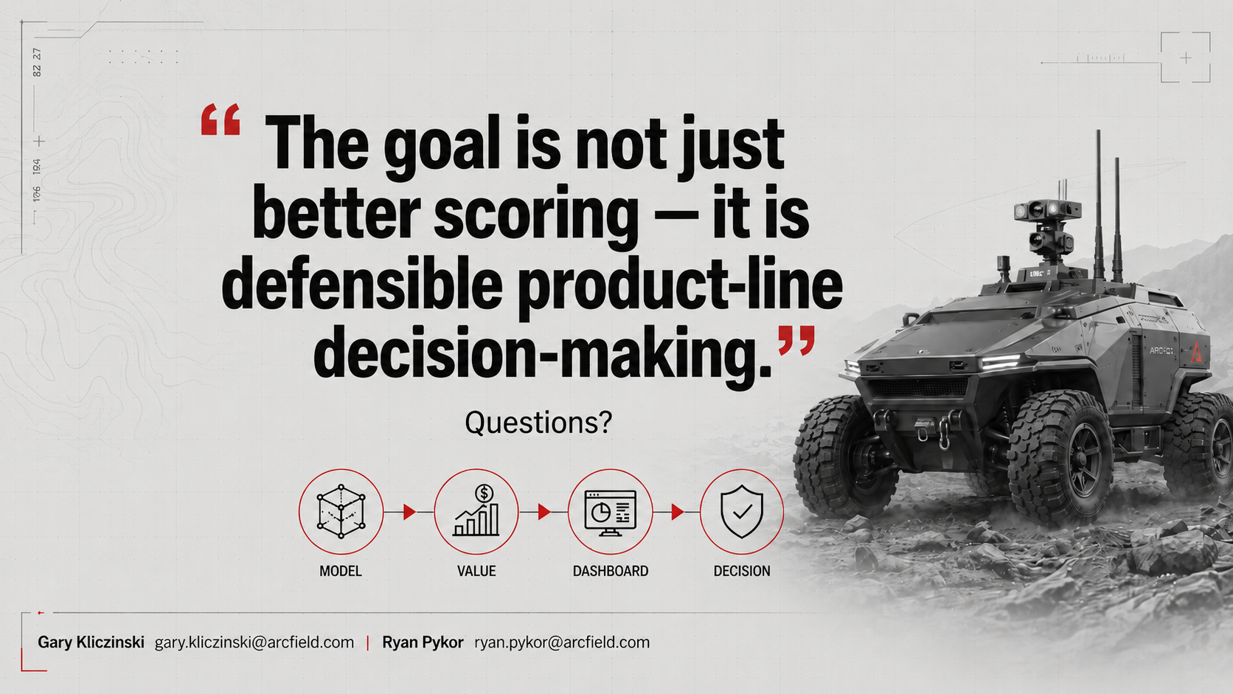
Closing / Q&A

Slide 15
MODEL-BASED PRODUCT LINE TRADE STUDIES WITH POWER BI VISUALIZATION
Gary Kliczinski / Ryan Pykor

